Slide 1
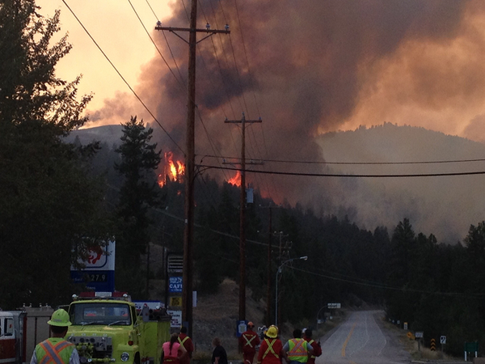
Emergency Response PlanNING for Pressure control Stations
T.M. (Taras) Sandulak, CD, MA (DEM), NCSO
Manager, Emergency and Business Continuity Programs
taras.sandulak@fortisbc.com
604-813-9009 (Mobile)
604-676-7013 (Office)

Slide 2
Bio & Background
T.M. Sandulak, CD, MA, NCSO
Manager, Emergency Management & Business Continuity Programs, FortisBC
Masters in Disaster & Emergency Management, Royal Roads Univ.
Professional Firefighter NFPA 1001 Level II
Hazmat Operations NFPA 472 Level II
Rescue Technician NFPA 1006 Level II
Incident Command System 400
Canadian Army, Infantry (NCO & Officer), 24 years
National Construction Safety Officer

Slide 3
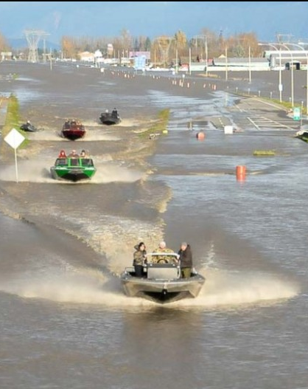
Some Definitions
All-Hazards Approach
Integrated approach to Emerg Planning that focuses on capacities and capabilities that are critical to preparedness for a full spectrum of emergencies or disasters regardless of origin or mechanism
Emergency Response Plan
Written framework on how to respond to any situation – with some specific actions to take (wildfire, flooding, earthquake etc.)
Emergency Procedures
What buttons to push, what levers to pull, what valves to spin and when
Highway 1 at Sumas Exit (Nov 2021)

Slide 4
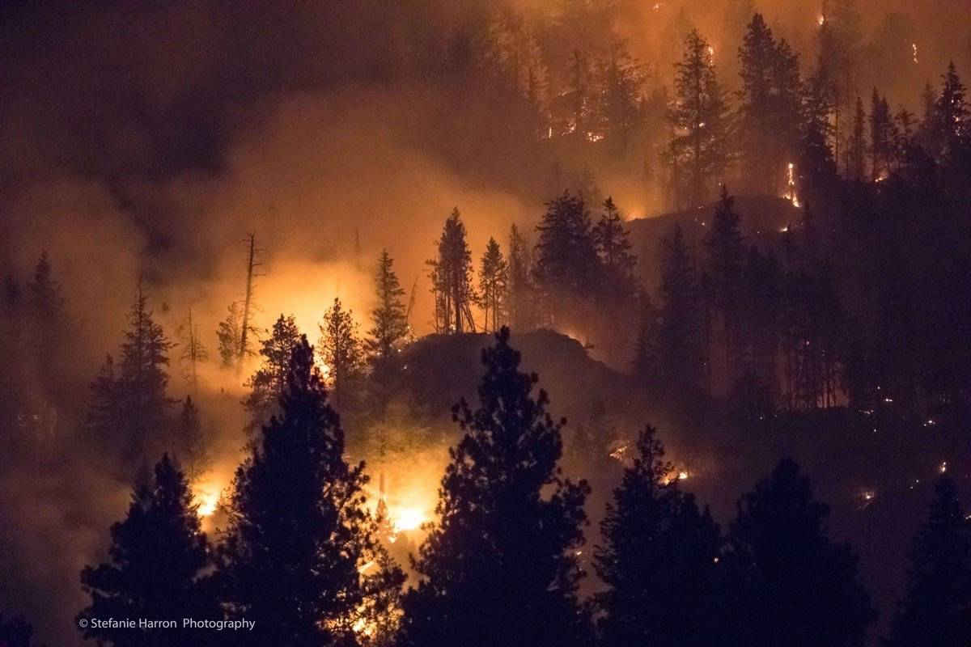
FortisBC Response Priorities
P
E
A
R
eople
    Responder and public safety
nvironment
    Minimize damage to environment
ssets
    Minimize damage to property
    Make systems safe for continued operation
estoration
    Services to customers
    Business functions

Slide 5
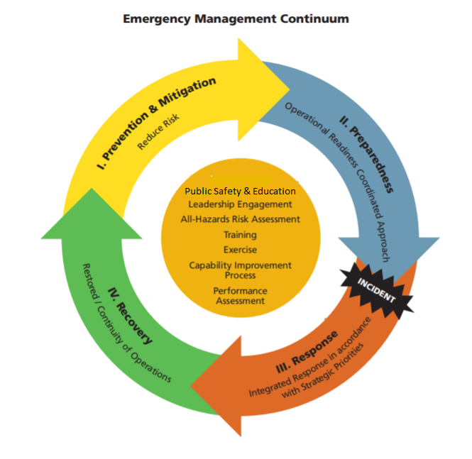

Training
Emergency Response Plans
Exercises
Exercise program & reports
Proactive measures
Re-establish operations
Business Continuity
Incident Command System (ICS)
Rehearsed coordination with external agencies
Emergency Response Plans
Forward Planning
*Image modified from Public Safety Canada

Slide 6
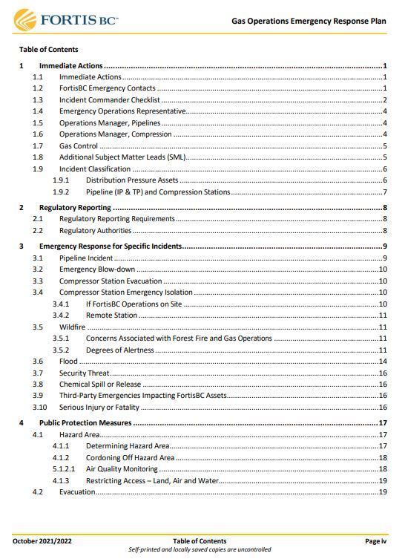
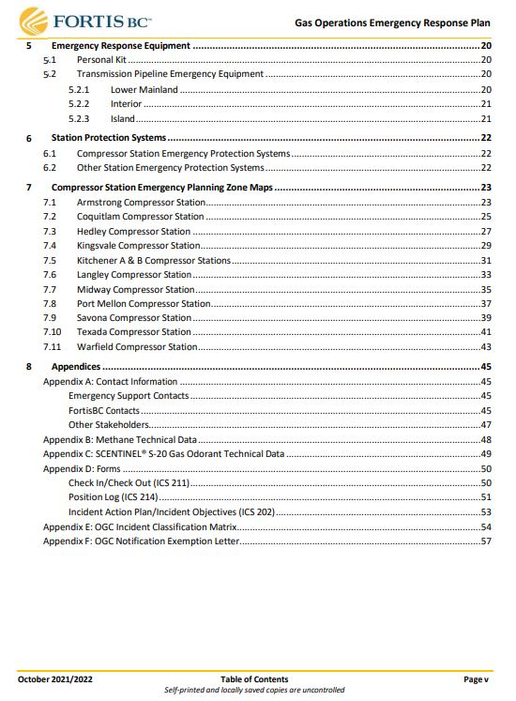
Plan Components

Slide 7
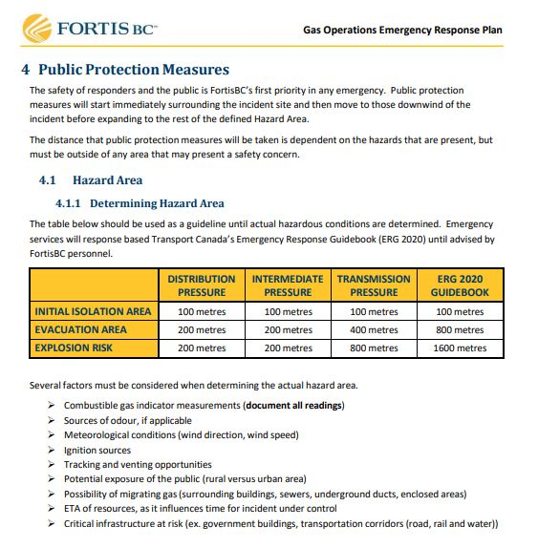
Plan Components Cont’d
No exhaustive detail
Simple, thin, easy to maintain familiarity
Offers suggestions vs “thou shalt do” – unless that’s required
Relies on experience and ground truth for flexibility

Slide 8

FortisBC’s Emergency Management Snapshot
34 Regulated Plans
FortisBC Emergency Program – Public facing website
FortisBC Corporate Emergency Response Plan (CERP)
Plans aligned with the CERP for consistency
Plans updated annually or IAW regulations
Emergency exercises (must test the plans!)
2021 - 32
2020 – 23
2019 – 20
2018 – 20
2017 – 21
2016 - 20
8 Regulators:
Transport Canada (TDG/ERAP)
National Energy Board
Environment Canada E2
BC Oil & Gas Commission
MRS (BCUC)
Dam Safety Regs
Hazardous Waste Regs
BC Ministry of Health
Notes:
Regulators are:
Transport Canada
National Energy Board
Environment Canada
BC Oil & Gas Commission
MRS (BCUC)
Dam Safety Regs
Hazardous Waste Regs
BC Ministry of Health

Slide 9
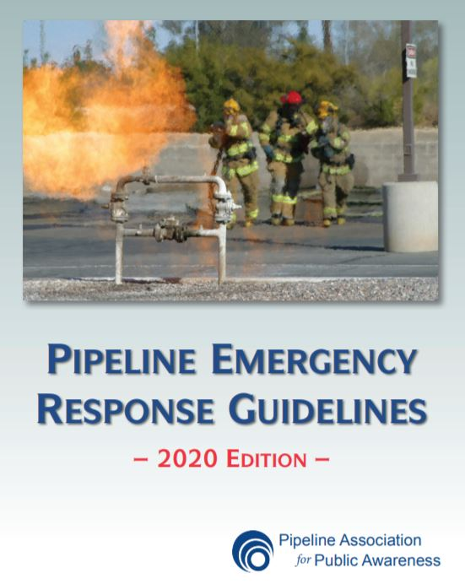
Discussion
Do you have an ERP?
  If yes – is it effective?
  If no – why not?
What are your assessed risks to your pressure regulator stations?
How do you map your ERP to the hazards/risks you’ve identified?

Slide 10
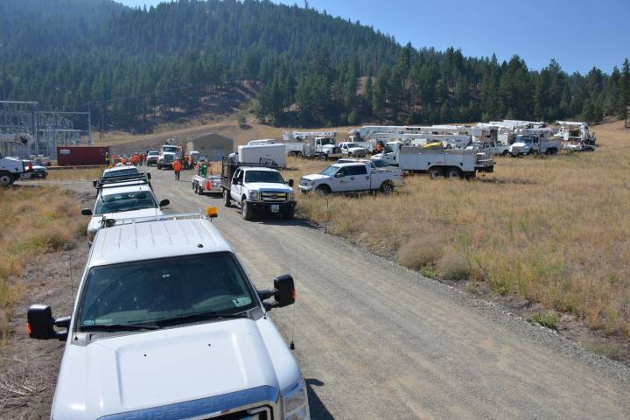
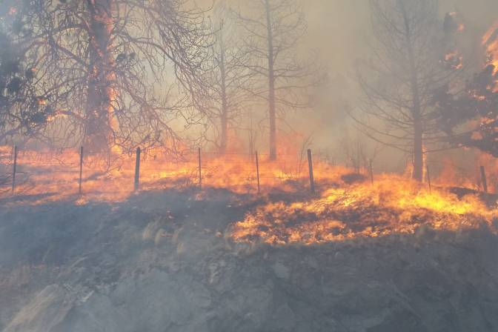
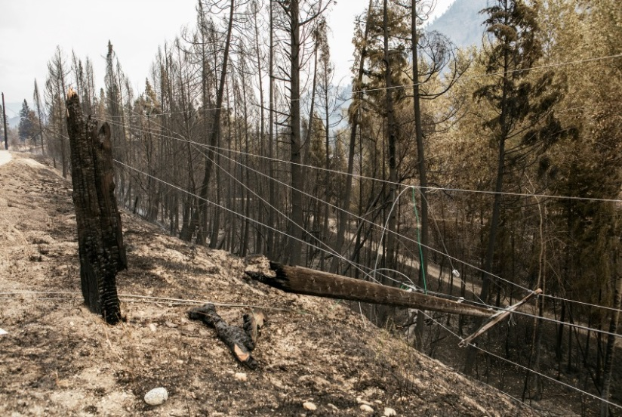
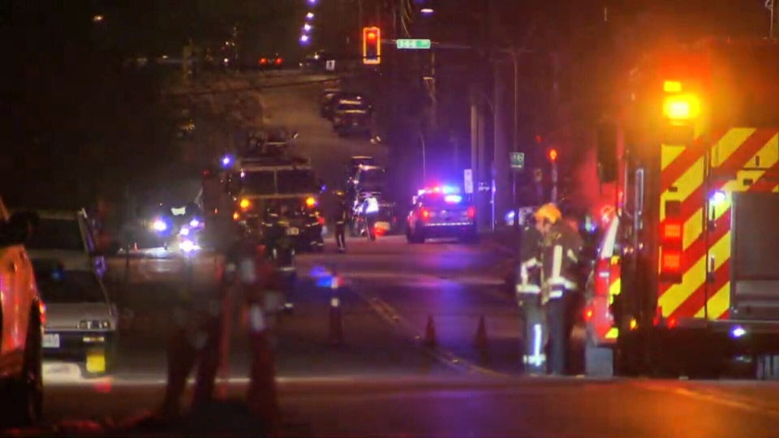
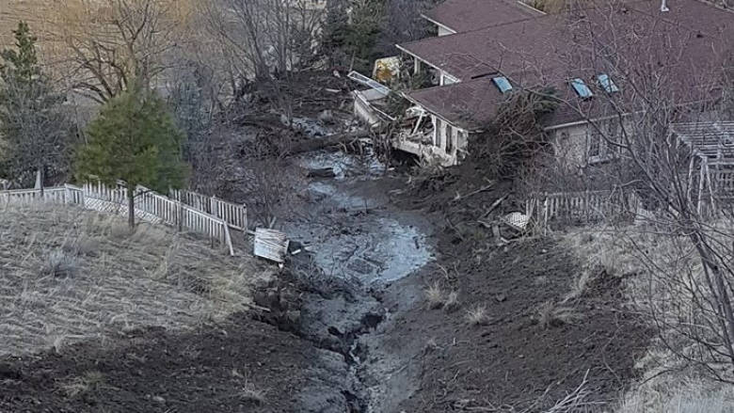
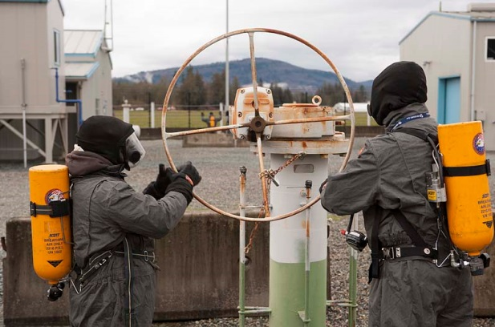

Slide 11



Questions?
T.M. Sandulak
Manager, Emergency and Business Continuity
taras.sandulak@fortisbc.com
604-576-7013 Office
604-813-9009 Mobile

