Slide 1
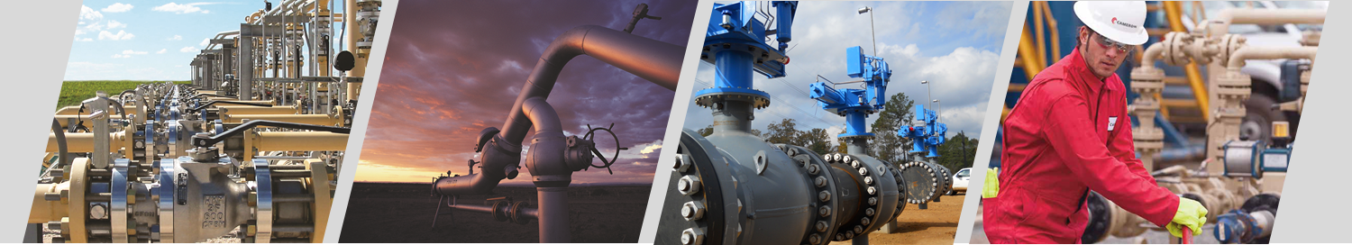


  Valve Maintenance: Ball Valves and Plug Valves
Mike Legittino
Western Gas Technologies
Regional Sales Manager
Notes:
THIS IS SLIDE # 01 IN THE BALL VALVE MAINTENANCE PRESENTATION.
Thank the Agent and Superintendent or Host by name and title.
Set the ground rules for the presentation --- Questions, Bathroom Visits, Getting A Drink, Sleepy, Break Times, etc....
There is one break scheduled in this presentation.

Slide 2
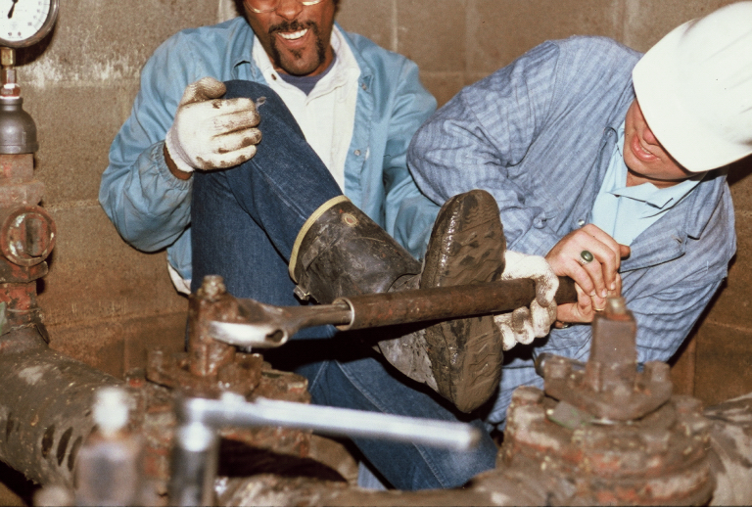
LOOK FAMILIAR??
Notes:
NOTES:_________________________________________________________________________________________________________________________________________________________________________________________________________________________________________________________________________________________________________________________________________________________________________

Slide 3






Common Valves

Slide 4
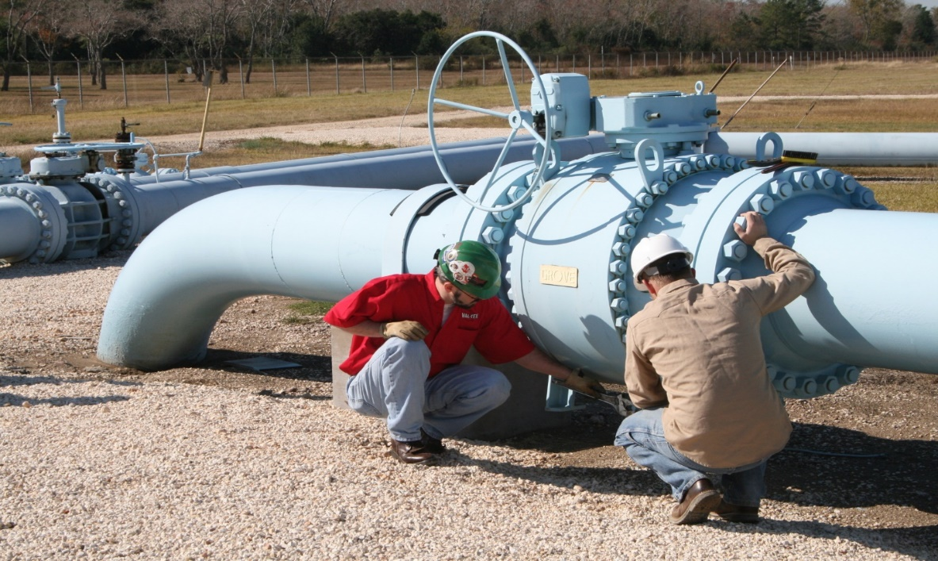
Preventative and Reactive Valve Maintenance
Reactive valve maintenance- can often be defined as the maintenance performed when the reliability or usefulness of system valves have depreciated or failed.
Preventative valve maintenance- suggests that we as pipeline operators take a proactive approach in mitigating valve issues before they occur.

Slide 5
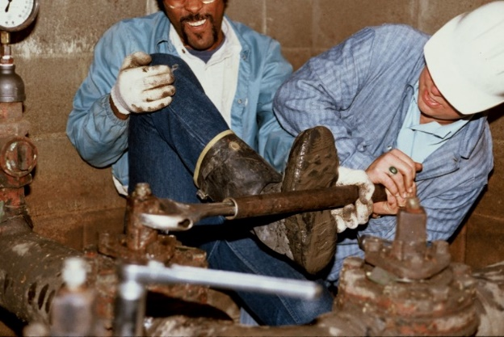
Reactive Valve Maintenance
It’s already too late.
Primary reason for hard to turn or inoperable valves is lack of maintenance
Repairing/ replacing valves is an incredibly costly undertaking
  Front end maintenance is a much cheaper option
Gradual Depreciation
  Could have been prevented

Slide 6
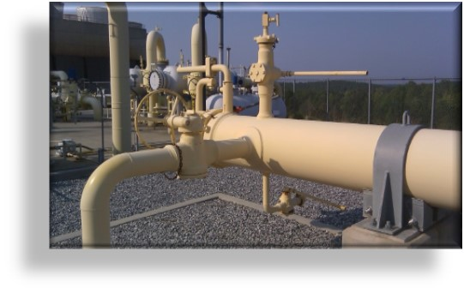
Preventative Valve Maintenance
Point of inoperability is when we wish we’d been more proactive
Too often valves looked at as a commodity
  Lack of maintenance compared to other pipeline components
Questions to ask yourself:
  How many valves do we have?
  What is critical?
  What compliance regulations do we have to follow?
  What kind of valves are they?
  How much can we allocate to these assets?
  How do we allocate our human resources?
Training, Training, Training! Know your valves!

Slide 7
Regulations
DOT Guidelines require “critical valves” to be maintained on a yearly basis
Critical valves- isolation valves, block valves and valves located near a high consequence area
  Vague
DOT recommendations = cycling 25%
Guidelines are open for interpretation
Regulations give a starting block for creating valve maintenance agenda

Slide 8
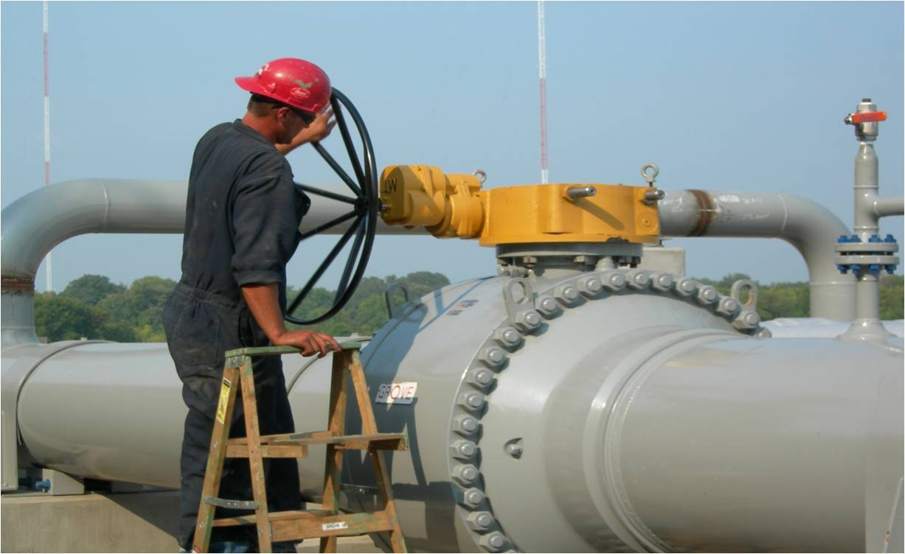
Valve Basics
Valve- a mechanical device that is used to control a liquid or a gas in a piping system.
  Most gas valves operate in a “clockwise closed” manner.
  There are different valve types with operating characteristics that vary from manufacturer to manufacturer.
  In order to operate & maintain a valve properly, a technician must know the mechanics of the valve and the consequences involved.
  More grease or a bigger wrench isn’t always the answer!
  KNOW YOUR VALVE

Slide 9
Vocabulary & Terms
Flow Control Element – Part of valve that obstructs and controls the fluid or gas, determines the valve type.
  Ball/ Plug/ Gate
Bore / Port – Inside diameter of the smallest opening of a valve. The bore can either be full or reduced.
Seat – Part of valve against which the flow control element effects a tight shut-off.
Stem – Part of valve that moves or pivots the flow control element.
Throttling – Intentionally restricting flow by partially closing a valve.

Slide 10
Vocabulary & Terms
Bi-directional – Product can flow through a valve in either direction.
Actuator – Device used to reduce the force required to manually operate the valve.
MWP (Maximum Working Pressure) - Indicates the maximum pressure at which a valve is rated at ambient temperature. ANSI ratings.
ANSI – American National Standards Institute; Principal standards writing organization for piping systems. ANSI pressure ratings are found on steel valves and fittings.

Slide 11
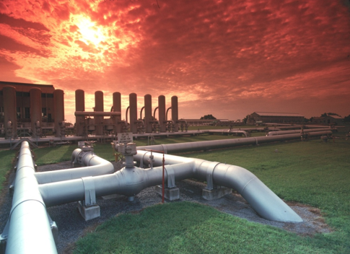
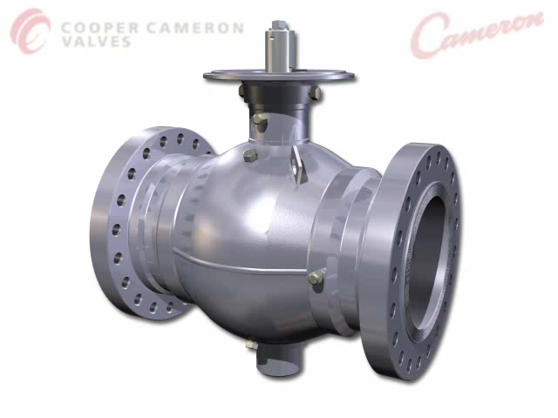
Ball Valves

Slide 12
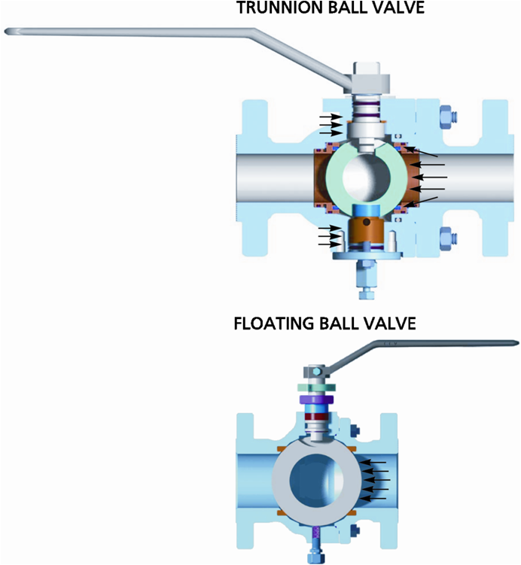
Trunnion vs. Floating Comparison
Trunnion - Designed for high pressure and/or large diameter applications in production and transmission.
  No size limit
  Seat moves to ball
  Lower Torque
  Lower actuation cost
  Ease of operation
  Double Block and Bleed Capability
Floating - Designed for smaller size and applications in production and process
  Limited to 12in. Bore size and smaller
  Ball moves to downstream seat to seal
  Economically Priced
  Trims available for multiple services

Slide 13
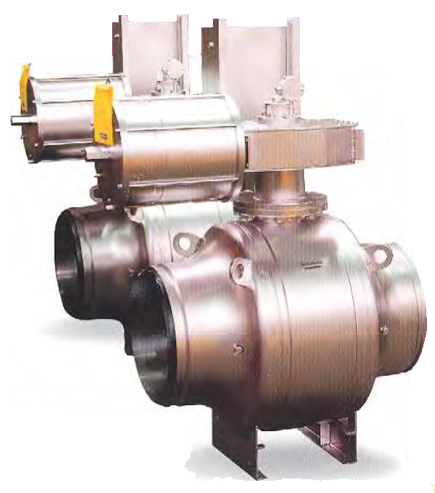
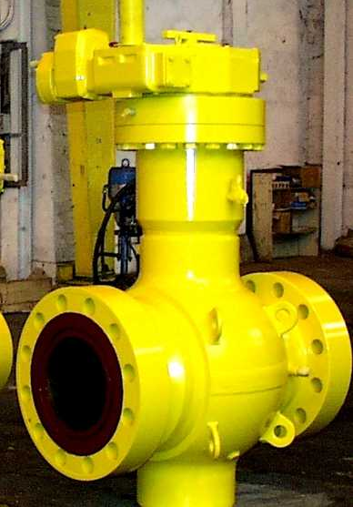
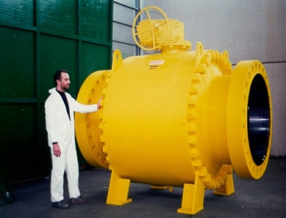
Body Designs
Leak Points, repairable, types of service
          Side Entry (Bolted Body).
                Welded Body
  Side entry bolting
  Body welds

Slide 14
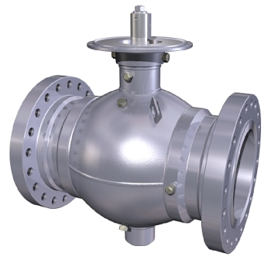
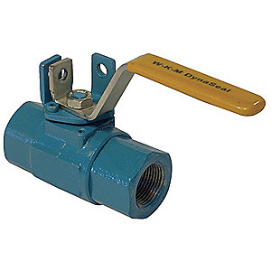
Valve Body Relief, Drain, Injection Points
  Stop Inspection Port
  Body Relief
  Stem Sealant Injection Port
  Body
  Blowdown
  Seat Injection Port

Slide 15
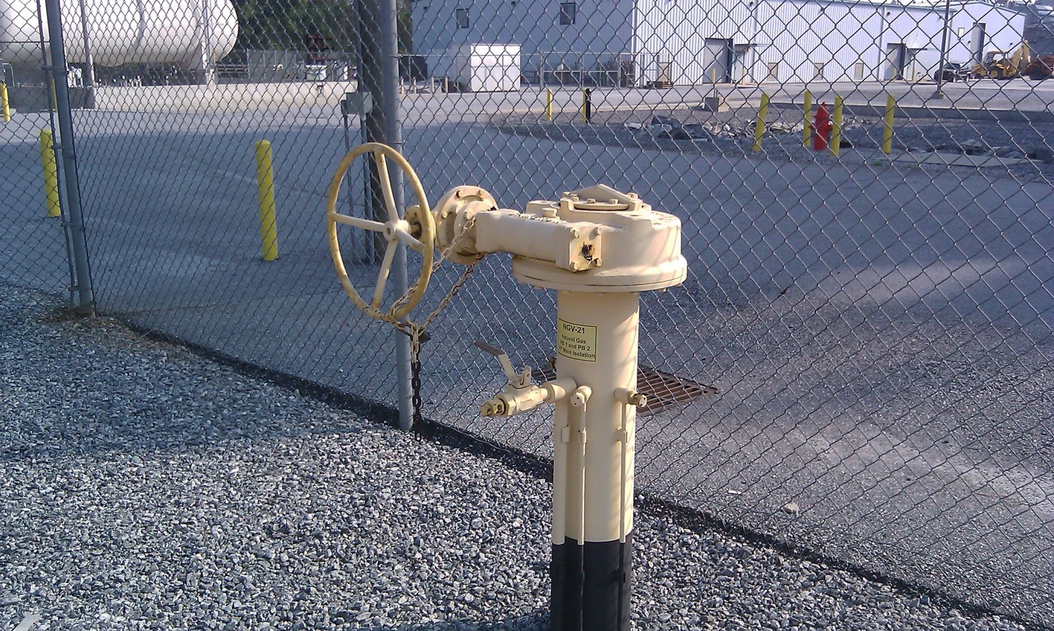
Buried Valve Configuration Example
Seat Fitting
Block & Bleed Fitting
Stem Fitting
16” Cameron Valve; Santee Cooper Power; Iva, SC

Slide 16
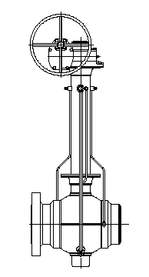
Buried Valve Configuration
Fittings are extended above ground along with the valve actuator.
Capped lube fittings are located at the upstream and downstream points. (Lube fitting extended through valve actuator indicates plug valve.)
Block & Bleed drain fitting is located at the mid-section of the valve.
Capped stem lube fitting or packing fitting may be located next to Block & Bleed fitting.

Slide 17
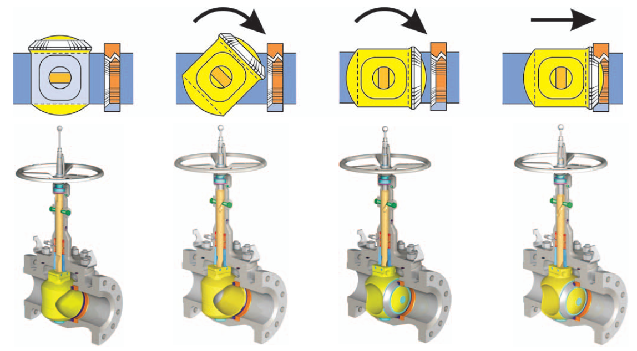
Mechanical Ball Valve Operation

Slide 18
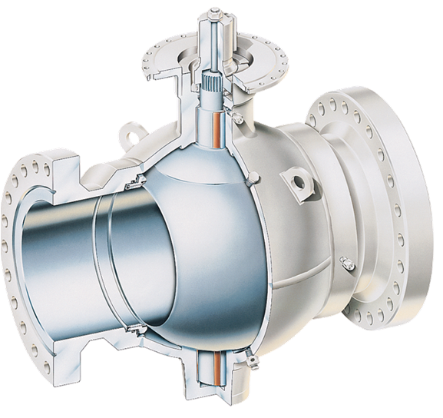
All-Welded Operation
Post 1985 only valves 14” and larger have rotating seats. Below 14” ball & trunnion is one piece.
T30 series valves have been in service since 1959.

Slide 19
All-Welded Disassembly

Slide 20
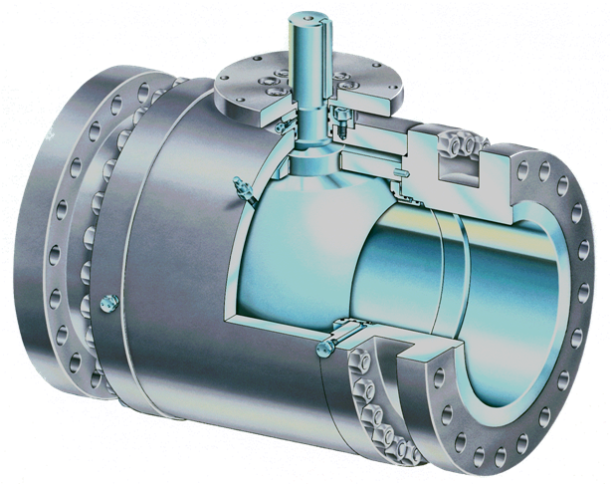
Bolted Body Disassembly

Slide 21
CAUSES OF LEAKING VALVES
External
  Verifying full rotation of the ball
Internal
  Grit/debris, seat damage
Stem leakage
Notes:
THIS IS SLIDE #13 IN THE BALL VALVE MAINTENANCE PRESENTATION.

Slide 22
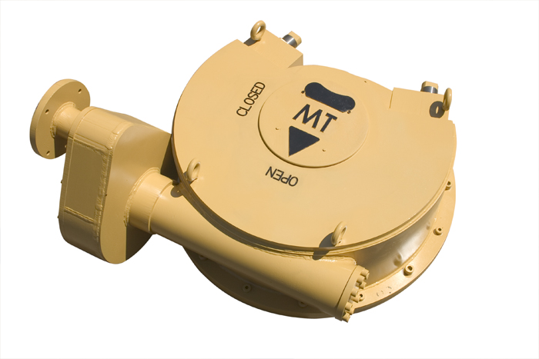
Gearbox Stops

Slide 23
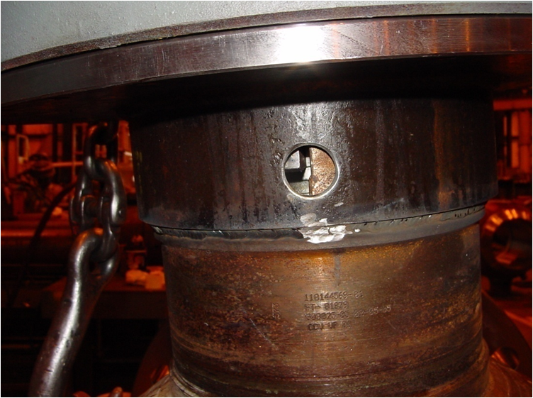
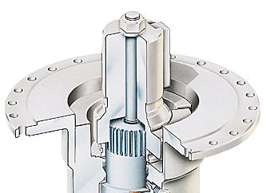
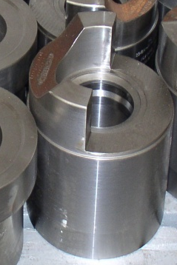
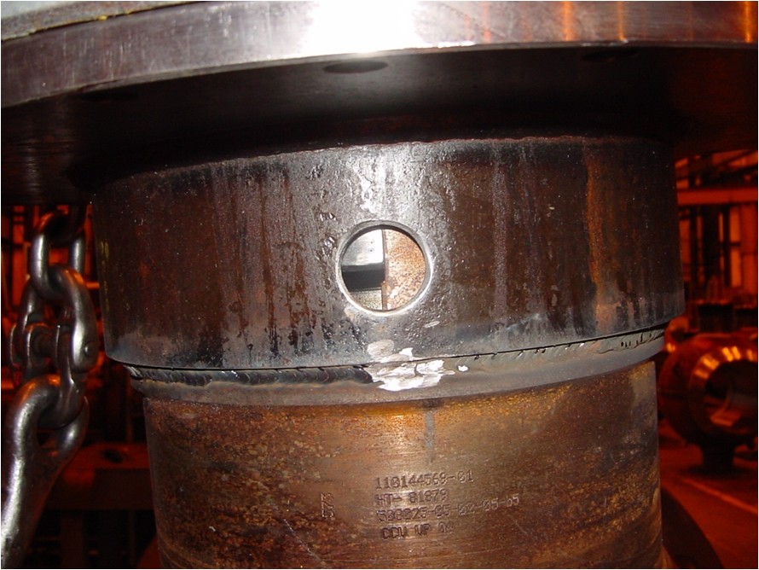
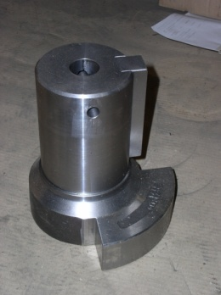
External Causes
All-Welded Stops
  Gap too wide
  Fixed Stop
  Mobile Stop
  Adjust stops to
  15/20 thousands
* Inspection ports only on 12” valves and larger

Slide 24
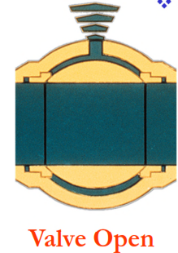
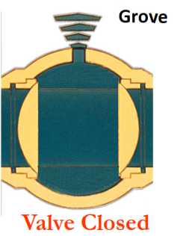
EXTERNAL CAUSES
Block and Bleed
Many ball valves seat on the upstream side.
Seat leakage can occur with the valve in either the open or the closed position. As a result, for many ball valves, it is possible to check the seats for sealing with the valve in either position.
Notes:
THIS IS SLIDE #42 IN THE BALL VALVE MAINTENANCE PRESENTATION.
A common ball valve problem is leakage past the valve seats. Keep in mind that most ball valves seat on the upstream side.
Seat leakage can occur with the valve in either the open or the closed position. As a result, it is possible to check the seats for sealing with the valve in either position. Remember, in the open position there is a lower volume of gas in the valve body cavity because the solid part of the ball is facing that cavity.

Slide 25
EXTERNAL CAUSES
Block and Bleed
For a quick check, ensure that the valve is in the full open position. This will reduce the volume of gas in the body cavity and the amount of time it takes to blow the valve down (except some Grove valves).
Before performing any work downstream of the valve, follow these same procedures with the valve in the closed position.
Notes:
THIS IS SLIDE #43 IN THE BALL VALVE MAINTENANCE PRESENTATION.
Test Procedures for Seat Leakage:
1. For a quick check, ensure that the valve is in the full open position. This will reduce the volume of gas in the body cavity and the amount of time it takes to blow the valve down. Before performing any work downstream of the valve, follow these same procedures with the valve in the closed position.
.

Slide 26
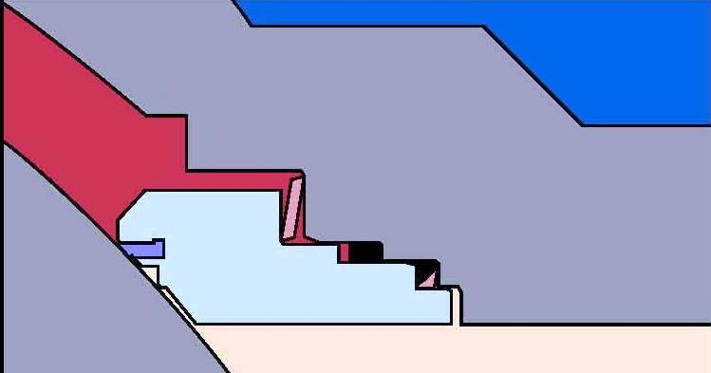
Internal Causes
Identify possible internal problems that the valve may have by checking the following four areas:
Seizure of the Seat Rings
  Seat differences
Damage to the Seat
Seat to Ball seizure
  Hardened grease
Icing
Notes:
THIS IS SLIDE #27 IN THE BALL VALVE MAINTENANCE PRESENTATION.
When you have eliminated all the external considerations on a valve that is hard to operate or is inoperable, the next step is to identify the possible internal problems that the valve may have by checking the following four areas:

Slide 27
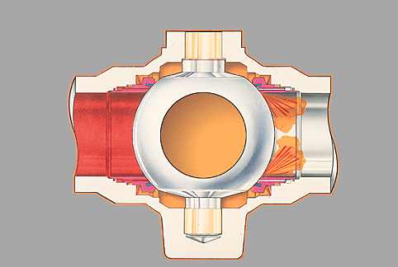
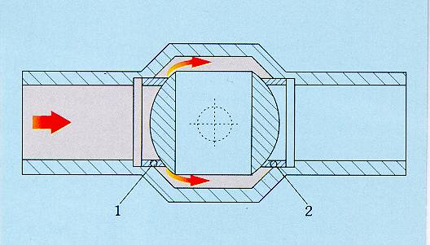
Seat Differences
Self Relieving –
Pressure build-up in the body cavity will increase to a pressure that exceeds the spring tension against the downstream seat assembly. The downstream seat will disengage from the ball at 200 PSI and relieve the body cavity pressure.
Double Piston Effect –
If the upstream seat becomes damaged and leaks, the pressure entering the body cavity acts on the downstream seat, sealing the downstream seat tightly against the ball. Seat springs perform this function in low pressure applications (50 PSI).

Slide 28
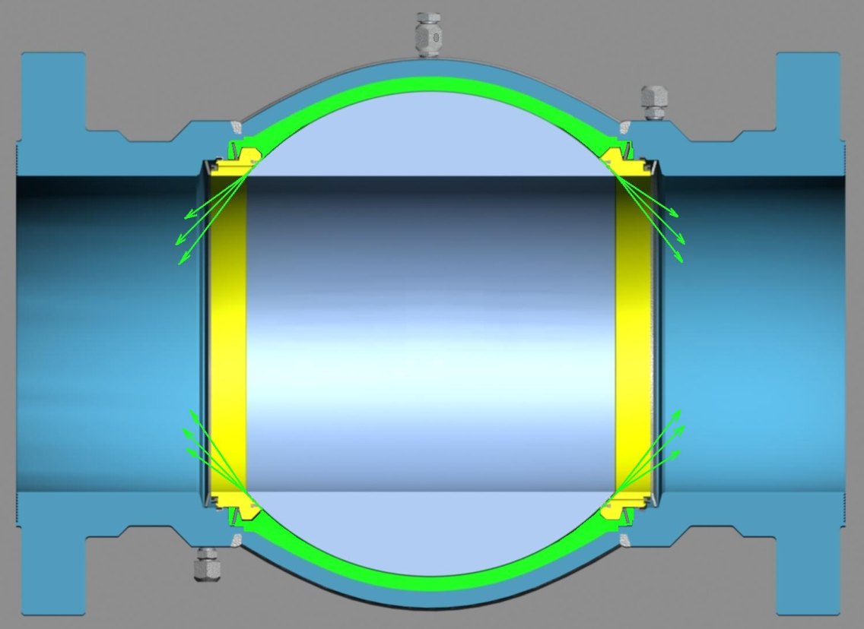
Self Relieving Seat Design Operation

Slide 29
Double Piston Effect Seat Design Operation
Upstream sealing
Downstream sealing

Slide 30
Internal Causes- 1
Seizure of the Seat Rings:
Trash from the line, sand, dust, rust or old, hardened sealants that contain solids can build up in the seat ring area and interfere with the movement of the seats. Seat ring seizure often results in leakage between the seat and the ball.
Corrective Action:
Inject Valve Flush to dislodge as much of the trash as possible. If you can, cycle the valve several times to further break-up the debris/corrosion.
Notes:
THIS IS SLIDE #37 IN THE BALL VALVE MAINTENANCE PRESENTATION.

Slide 31
Internal Causes - 2
Damaged seat(s) and/or ball:
Trash from the line, sand, dust, metal shavings or rust can damage the sealing surfaces of the seat and ball. These cuts often result in leakage between the seat and the ball.
Corrective Action:
Inject Valve Flush to dislodge as much of the trash as possible. If you can, cycle the valve several times to further break-up the debris. Follow valve flush with a Sealant material

Slide 32
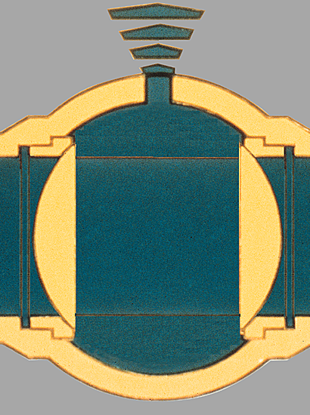
Internal Causes - 3
Seat-to-Ball Seizure:
If a valve with a floating or fixed seat has not been operated for a long period of time, the seat will tend to take a “set” against the ball. This condition requires additional force to break the ball loose and allow operation of the valve. High line pressure will also contribute to this increased initial operating torque.
Notes:
THIS IS SLIDE #32 IN THE BALL VALVE MAINTENANCE PRESENTATION.
3. Seat-To-Ball Seizure:
If a valve with a floating seat has not been operated for a long period of time, the seat will tend to take a “set” against the ball. This condition requires additional force to break the ball loose and allow operation of the valve. High line pressure will also contribute to this increased initial operating torque.

Slide 33
General Ball Valve Maintenance
Valve manufacturers recommends Valve Flush
Full Open or Full Closed Position
Inject Flush into both seat pockets
DO NOT INJECT LUBE SEALANT INTO STEM INJECTION FITTING UNLESS YOU HAVE A LEAK
Abide by valve IOM injection pressures
  One Piece, fully welded
    < 4” = 4,000 psi
    > 6” = 6,000 psi
  Multi piece- Bolded Body
    2,500 psi over line pressure

Slide 34
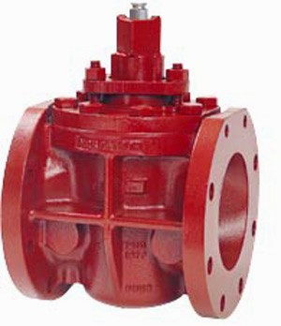
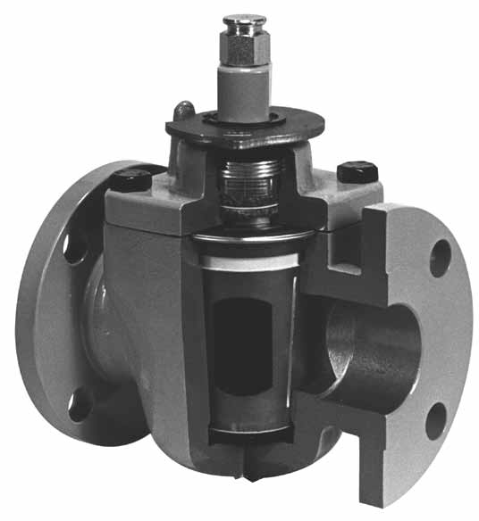
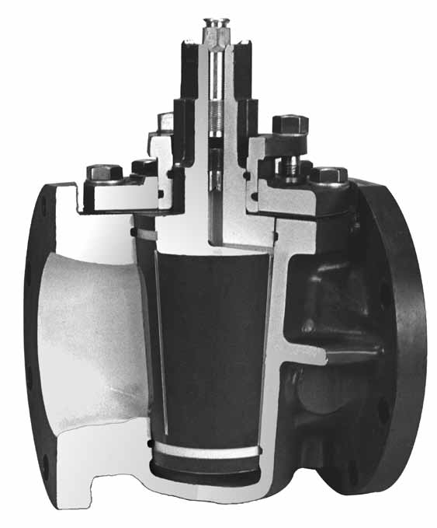
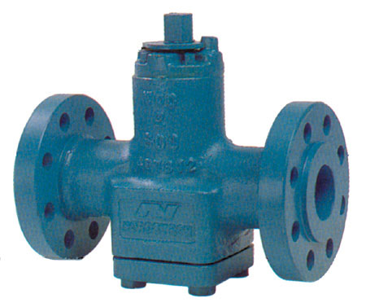
Plug Valves: Block or bypass valves

Slide 35
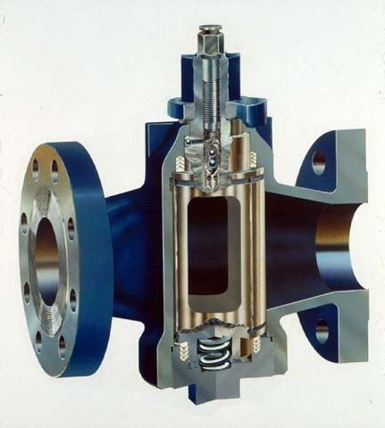
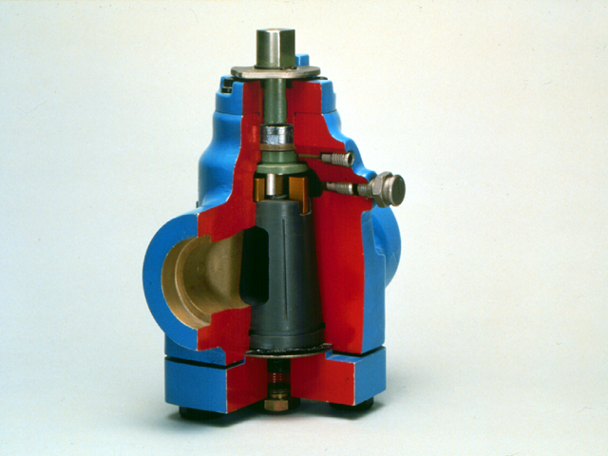
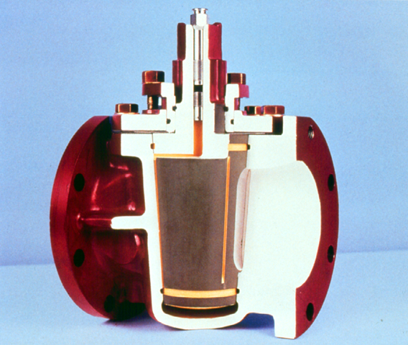
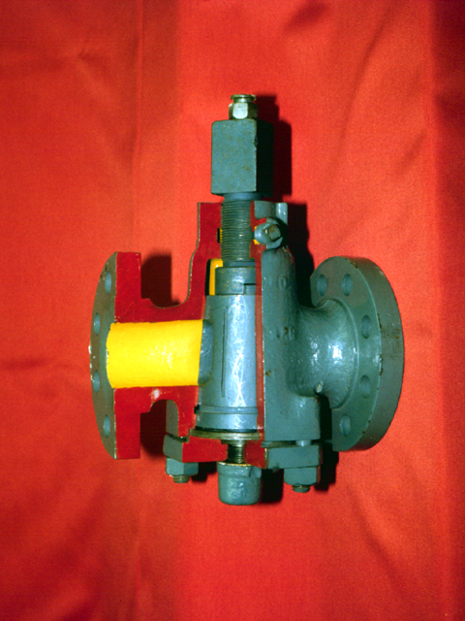
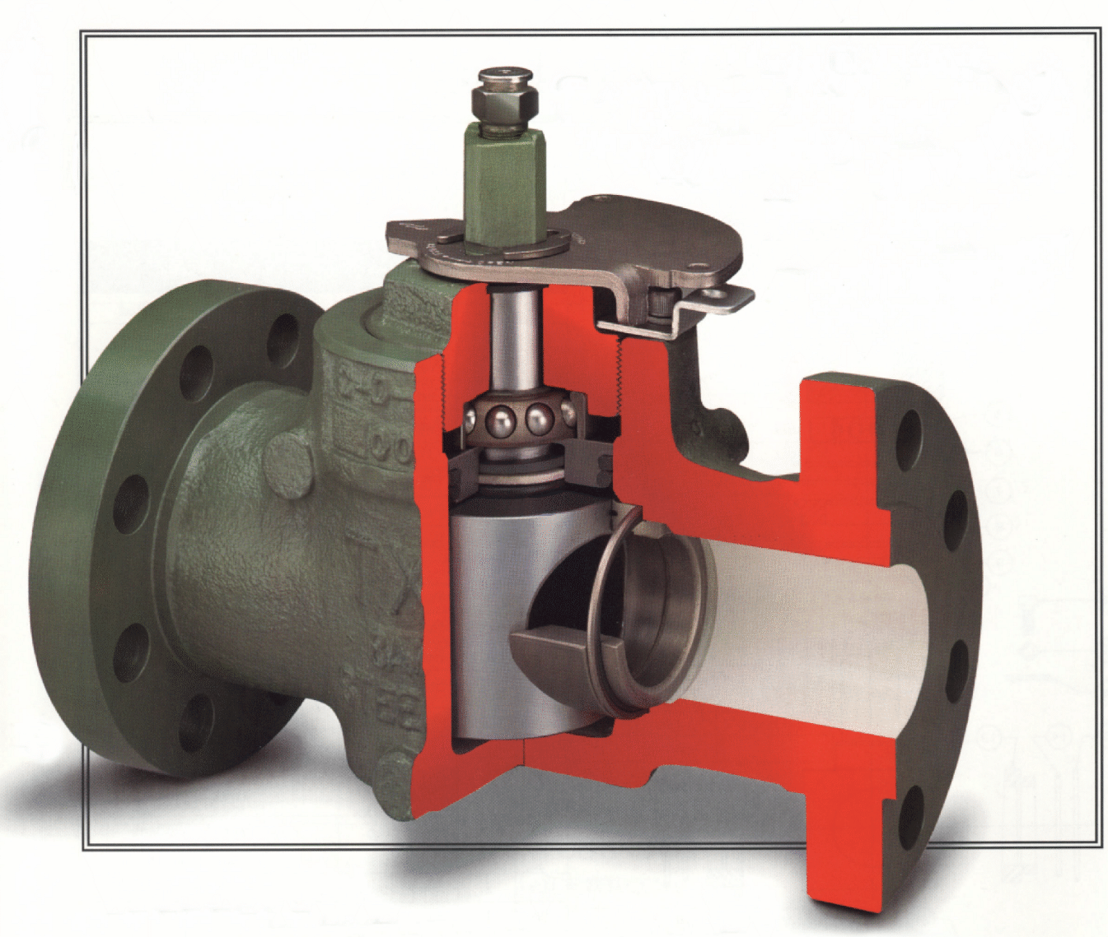
Plug Valves
There are four types commonly found:
Tapered Plug Valves
Hypreseal or Bottom Entry Valves
Dynamic Balanced Plug Valves
Cylindrical Plug Valves

Slide 36
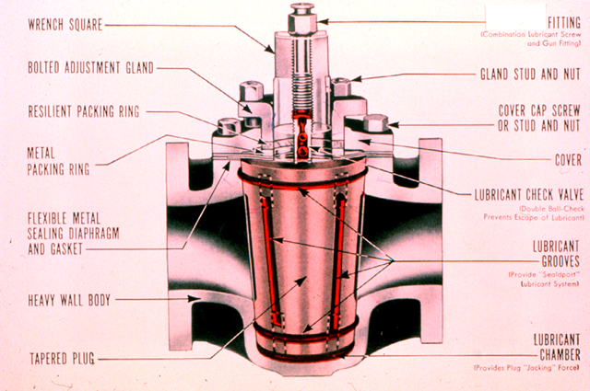
Plug Valves Parts Breakdown

Slide 37
CAUSES OF HARD TO OPERATE, LEAKING OR FROZEN AND INOPERABLE VALVES
  Lack of periodic lubrication and/or not injecting enough product.
  Using the wrong product (not suited for the service).
  Corrosion between the bonnet packing gland and the stem in the tapered plug
Formation of solid fillers in the lubrication grooves such as clays, talc, Teflon or other solids.
The valve is not in proper adjustment. There is usually a tendency to loosen the bonnet on valves that are hard to turn.
Any combination of the above.
Notes:
NOTES:_________________________________________________________________________________________________________________________________________________________________________________________________________________________________________________________________________________________________________________________________________________________________________________________________________

Slide 38
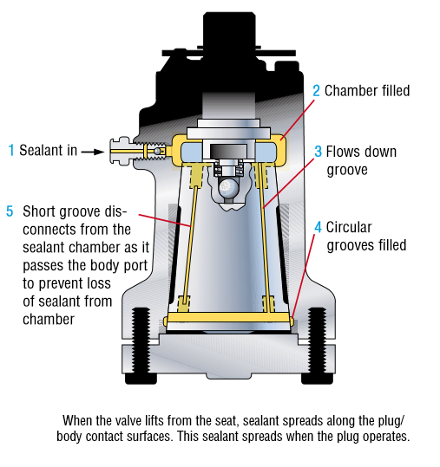
Why Lubricate a Plug Valve?
To act as a hydraulic medium:
  For the majority of plug valves, application of lube sealant under pressure lifts a tapered plug off its tapered seat
Lubricity:
  Lube sealant coats both the tapered plug and the tapered body in the valve body, making them slippery and allowing easier turning at reduced operating torque
To act as a seal:
  The valve lube sealant must fill the clearance between the plug and the body to keep the valve from leaking. The lube sealant must be replenished periodically or the valve will leak. Injection frequency depends on the resistance of the lube sealant to wash-out, pressure extrusion and frequency of operation

Slide 39
WHAT ARE THE KEYS TO SOLVING THESE PROBLEMS?
A preventative valve maintenance program that includes :
  Proper lube sealant for the service conditions
  Proper storage practices
  Scheduling routine maintenance
  Valve Flush for hard to turn and/or leaking valves
  Efficient lubrication equipment
  Correct injection techniques
  Continuing valve maintenance education
Notes:
THIS IS SLIDE #023 IN THE PLUG VALVE MAINTENANCE PRESENTATION.

Slide 40
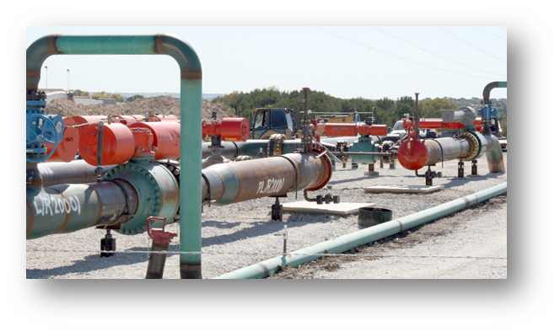
Storage
Visual valve inspection upon receipt
  Name badge, test results, shipping damages, coating imperfections.
Valve in the full open position
End covers intact
Indoor storage
Clean dry safe environment

Slide 41
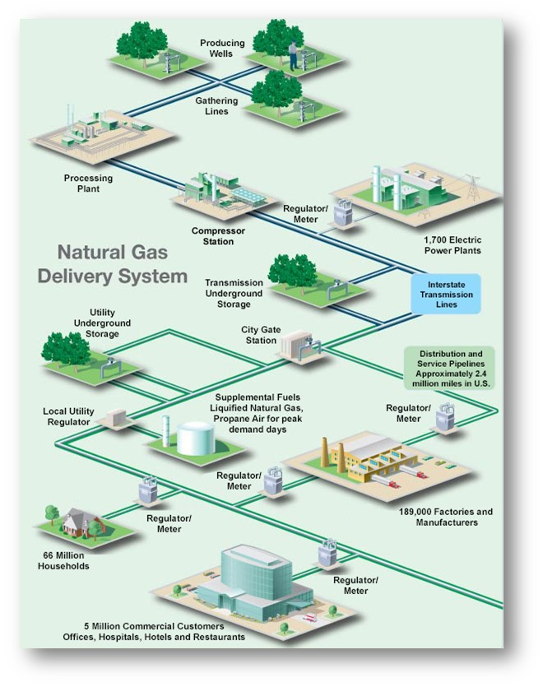
Scheduling Maintenance
Scheduled routine of lubricant/sealant top offs, valve cycling, etc.
New valves typically require more maintenance than valves that have been in service
  Seals and seats sit tighter to the flow control element
Based off DOT recommendations
Critical valve definition
  Defined by application.
    What is downstream?
  Non-Critical
Timeline for maintenance
  Yearly basis
  Rotational basis
Create Checklists
Continuing to be reactive is not going to fix valve problems
Routine Preventative Valve Maintenance is not labor intensive

Slide 42
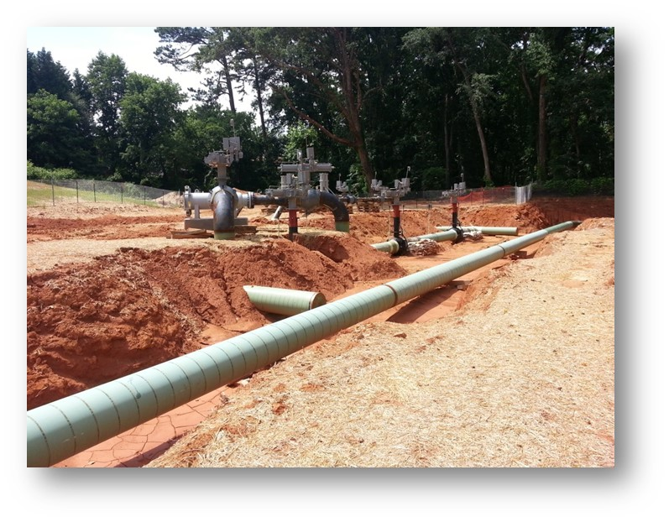
Installation and Commissioning
Majority of issues occur during installation
Know your contractors
IOM manuals
  Prep instructions
  Heating instructions
  Welding instructions
  Hydro Procedures
  Torque specs
Flush throughout the installation process

Slide 43
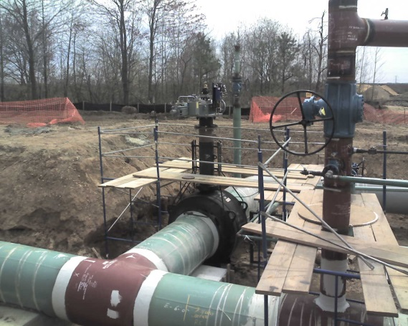
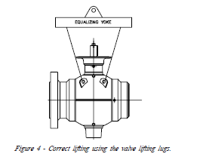
Installation Practices
Verify pressure class rating.
Operate the valve prior to installation.
  Insure full travel
  Insure proper placement/orientation of actuator
Protection of Ball:
  Ball should be fully open during the installation of the valve.
  If the ball must remain in the closed position during installation, coat the exposed surfaces of the ball with grease. This will protect the ball from being damaged due to weld splatter.
Welding: When preheating, welding or stress relieving, body temperatures must not exceed 400F at any point beyond 3” from the weld. Use tempil sticks to check temperatures. Before valve is welded in to final position, cover the valve seal areas with 1” wide masking tape from the 3 o’clock to the 9 o’clock position. This will help prevent any foreign material from becoming lodged in these areas.
Test the valve for leakage.
  Thoroughly remove water from valve interior if hydrostatic test is performed.
  Tighten all maintenance fittings.
Provide proper support before backfilling.

Slide 44
Hydrostatic Testing – Ball Valve
Hydro:
PRE: Valve should be fully open position while filling the system to allow debris to be flushed through the valve bore
DURING: Valve should be placed in the partially open position (approx. 10% from fully open) to allow test fluid to fill valve cavity
POST: Valve should be fully open position while draining the system to allow debris to be flushed through the valve bore
POST: BEFORE OPERATING THE VALVE FOR THE FIRST TIME FLUSH BOTH SEATS TO DISPLACE TEST FLUID AND ANY DEBRIS FROM SEAT- BODY JOINT
Verify open / Closed valve stops (and/or actuator stops) before placing valve in service
  When pigging operations conclude, inject cleaner or lubricant into seat ring pockets to displace trapped water, drain the body cavity of any remaining water, then place valve into final positioning.

Slide 45
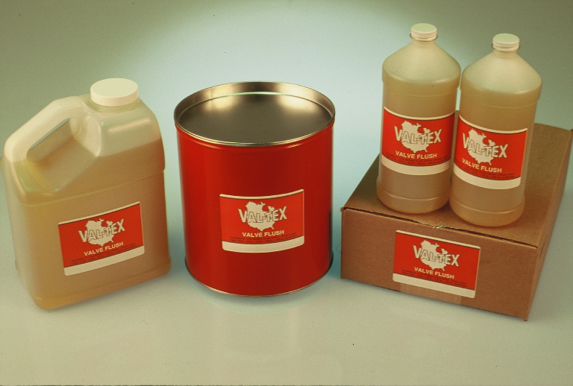

Flush Sealant Progression
Valve Flush
Penetration
Pressure
Pipeline Debris
Until we move pipeline debris or old hardened sealants that contain solids out of the way, we can not create a bead of lube sealant where we want it.
Do NOT grease until you Flush!!!

Slide 46
Flush Sealant Progression
Flush
Lube
Seal-Bulk
Seal-Stick
Seal w/Teflon
Always Flush when fighting leaking and/or hard to operate valves
Lubricate new valves
Bulk-Sealant allows heavy lubrication + light sealing
Stick-Sealant allows light lubrication + heavy sealing (higher viscosity)
Teflon should only be used in extreme emergencies

Slide 47
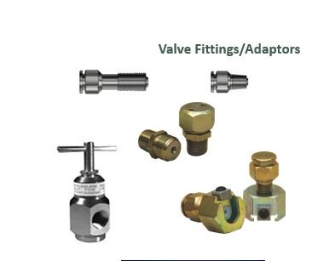
Injection Pressures
Line Pressure
Distance
Viscosity
  Flush – 1000psi
  Bulk- 1250psi
  Stick- 1500psi

Slide 48



Hand Held Hydraulic Injection Pump
HYDRAULIC GREASE GUN WITH CASE
- Generates up to 10,000 psi
- 44 strokes per ounce or 352 strokes per stick
- Barrel holds up to 12 oz. of sealant
- Generate hydraulic pressure easily
ALWAYS USE A HIGH PRESSURE INJECTION GAUGE

Slide 49


Pnuematic Grease Guns
Bulk Material
Tough – Fast - Mobile
Pneumatic hose assemblies.
Control is placed into the hands of the tech. Standing next to the valve, the tech can throttle delivery speed, watch injection pressures and relieve coupler pressure; the safest design.
Simple load the can or pail, connect air and squeeze the control handle.
Fewest moving parts means there is less fuss, the gun is easier to maintain and has less field problems.

Slide 50

Capacity Card
Durable laminated card that gives you the approximate amount of Valve Flush & Sealant required for various types and sizes of valves.
How many strokes using a hand held grease gun does it take to
fully lubricate a 12” Cameron?
440 strokes = 10 ounces
How many strokes using a hand held grease gun does it take to
fully lubricate a 4” Nordstrom?
220 strokes = 5 ounces
Key Takeaways:
Always refer to the Val-Tex Capacity Card to ensure you inject the correct amount of Valve Lube, Flush or Sealant
Routine maintenance with the proper lube sealant and/or flush is your best assurance of trouble free valves
Field formula for problem valves, an ounce of lube sealant per inch of valve size
Field formula for annual maintenance, a quarter of that amount

Slide 51


Pressure Gauge Reading Techniques
In order to determine what is happening inside the valve, every gun or pump should be equipped with a working high-pressure gauge. Watch the gauge climb as sealant is injected; if the valve seat sealant system is empty, the gauge will build pressure with each stroke and drop off very quickly. As the seat sealant system fills, the gauge will drop off more slowly. The slower the gauge drops off, the tighter the fit between the seal faces. This is usually a good indication that the valve will seal when required. Cold weather will effect the viscosity of the sealing compounds and can give confusing signals. Practice pumping in all climates and conditions so you better understand by watching the movement of the gauge when the lubricant / sealant is moving into the valve passages

Slide 52
WHY INJECT VALVE FLUSH?
Valve is hard to turn
  Using cheater pipes to turn valve
  Difficult to turn or feels like there is “grit” in the valve
Valve is leaking
  Hardened deposits of old lubricants and sealants
  Debris from pipeline
Notes:
THIS IS SLIDE #027 IN THE PLUG VALVE MAINTENANCE PRESENTATION.

Slide 53
LUBRICATION GUIDELINES
If the valve continues to leak after injecting Valve Flush, the sealing surfaces may be severely worn or damaged. Consider the following options:
  If you have been using a lubricant, try injecting bulk grade lube sealant which has a higher viscosity.
  If you have been using bulk lube sealant, try injecting stick grade which has a higher viscosity.
  As a last resort, a Teflon® filled lube sealant may be used. Repeated use of lube sealants with Teflon is not recommended.
Notes:
THIS IS SLIDE #096 IN THE PLUG VALVE MAINTENANCE PRESENTATION.

Slide 54
Closing Questions
Mike Legittino
Western Gas Technologies – Regional Sales Manager
630-253-7011
m.legittino@westerngastech.com
www.westerngastech.com

