Slide 1
Odorization 101
Presented By: Steve Sams, PE
welker.com
Notes:
A family-owned company in Sugar Land, Texas, Welker designs and manufactures innovative solutions for the oil and gas industry and beyond. With 65+ years of industry experience.

Slide 2
Agenda
What is Odorization?
Types of Odorizers
Installation Consideration
Supporting products and technologies

Slide 3
What Is Odorization & Why?
Odorization is the process of adding odorant to natural gas
so that its presence can be detected by people

Slide 4
What Prompted the Regulation?
Federally required, for the safety of the public.
In 1937, there was an explosion that leveled an elementary school in New London, Texas, killing 311 people of which the majority were children.
Notes:
A new school had been built in a wealthy oil town. It had a natural gas boiler in the basement, and when a shop teacher switched on the light the school blew up. The town lost an entire generation on that day. This made international news and led to a worldwide outcry for safer gas delivery.

Slide 5
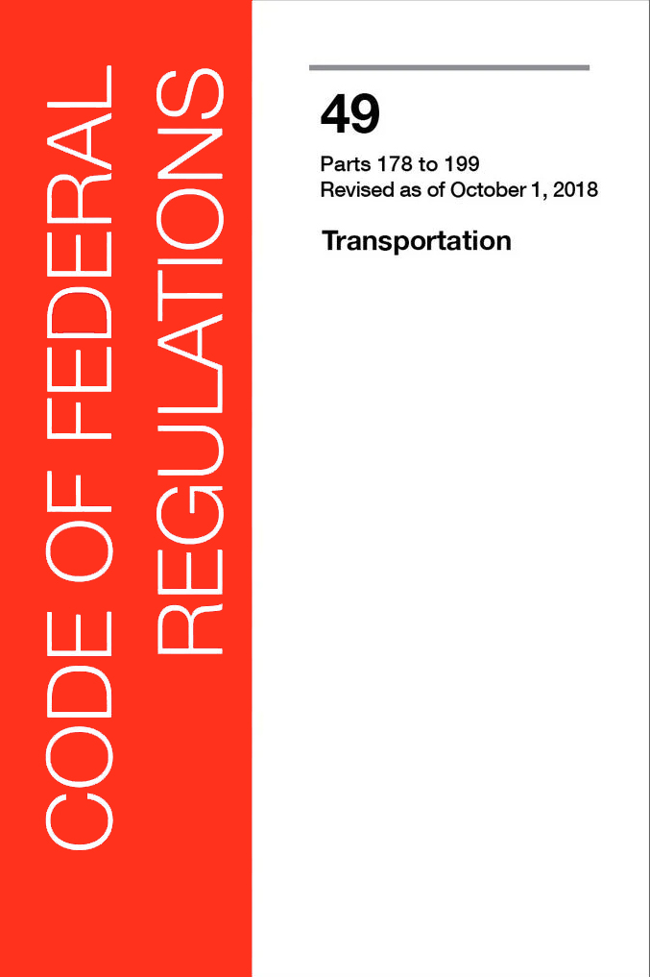
How Do We Odorize?
REMEMBER
CFR Title 49 Part 192.625
Code of Federal Regulations
“A combustible gas in a distribution line must contain a natural odorant or be odorized so that at a concentration in air of 1/5 (20%) of the lower explosive limit, the gas is readily detectable by a person with a normal sense of smell.”
Notes:
Natural gas is explosive at an LEL of 5% in air, so the odorant must be readily detectable at a 1% concentration of natural gas in air. The sniff test is important because there can be constituents in the gas that mask the ability to smell the odorant even if concentration levels are unchanged.

Slide 6
How Do We Odorize?
REMEMBER
CFR Title 49 Part 192.625
Code of Federal Regulations
“Equipment for odorization must introduce the odorant without wide variations in the level of odorant.”
Notes:
Natural gas is explosive at an LEL of 5% in air, so the odorant must be readily detectable at a 1% concentration of natural gas in air. The sniff test is important because there can be constituents in the gas that mask the ability to smell the odorant even if concentration levels are unchanged.

Slide 7
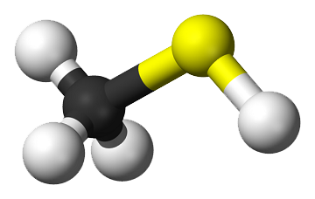
What is Odorant?
In the US, usually TBM based blends
Detectable at < 1PPB
Highly flammable
Non-toxic to mammals
Toxic to aquatic life
Notes:
Two odorant manufacturers, make the same blends under different trade names

Slide 8
Odorization Rates
In the US, lbs of odorant per million standard cubic feet (lbs/MMSCF)
Typical injection rates range from 0.5 to 1 lb/MMSCF
Typical alarm rates at around 0.35 (low) and 1.5 (high)
Notes:
Two odorant manufacturers, make the same blends under different trade names

Slide 9
Odor Fade
Odor fade can occur for a variety of reasons:
New steel pipe will strip odor
Cleaning agents can strip or mask odor
Accumulated liquids in low sections of pipe – especially below rivers or lakes
Notes:
Two odorant manufacturers, make the same blends under different trade names

Slide 10
What is Pickling?
Mercaptan interacts with new steel which removes the odor from the gas
It is necessary to precondition (pickle) the line to prevent this
This is an entire webinar of its own
Notes:
There are companies that can perform this for you or provide consulting services

Slide 11
Methods of Odorization
Wick
Passive Bypass
Injection Pumps
Pumpless Vapor/Pumpless Liquid

Slide 12
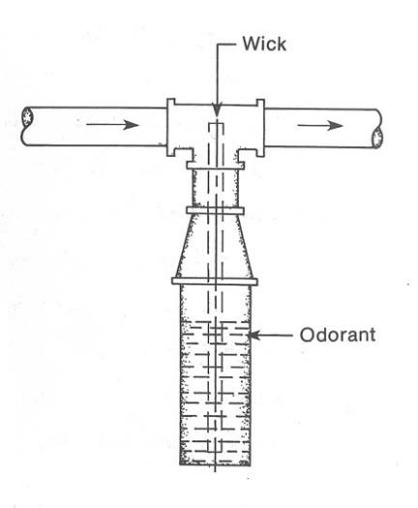
Odorizer Method Wick
How It Works
Odorant is drawn up the wick from the container and into the gas stream
Disadvantages:
During low or high flow periods, the gas can be under/over odorized
No documentation of correct odorization
Notes:
Really only appropriate for farm taps due to low gas flow rates that it can odorize

Slide 13
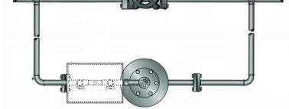
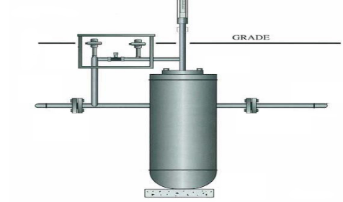
Odorizer Method Passive Bypass
How It Works
A small amount of mainstream gas is bypassed through the unit, and the odorant–laden gas is returned to the main line
Disadvantages:
Not a good solution for wide variations in flow rate or pressure
No documentation of odorant delivered
KingTool is the most well-known manufacturer in this niche
Notes:
Actual odorization rates vary with pressure, temperature, and gas flow. The adjustments are made by tweaking the gate valves and feedback is by periodic sniff tests.

Slide 14
Smart Odorizers
Monitor gas flow and inject proportional to flow
Monitor their own performance and adjust or alarm appropriately
Are fully compliant with US 192.625
Do not experience the high and low odorization swings of passive systems
Are more sophisticated, therefore more expensive

Slide 15
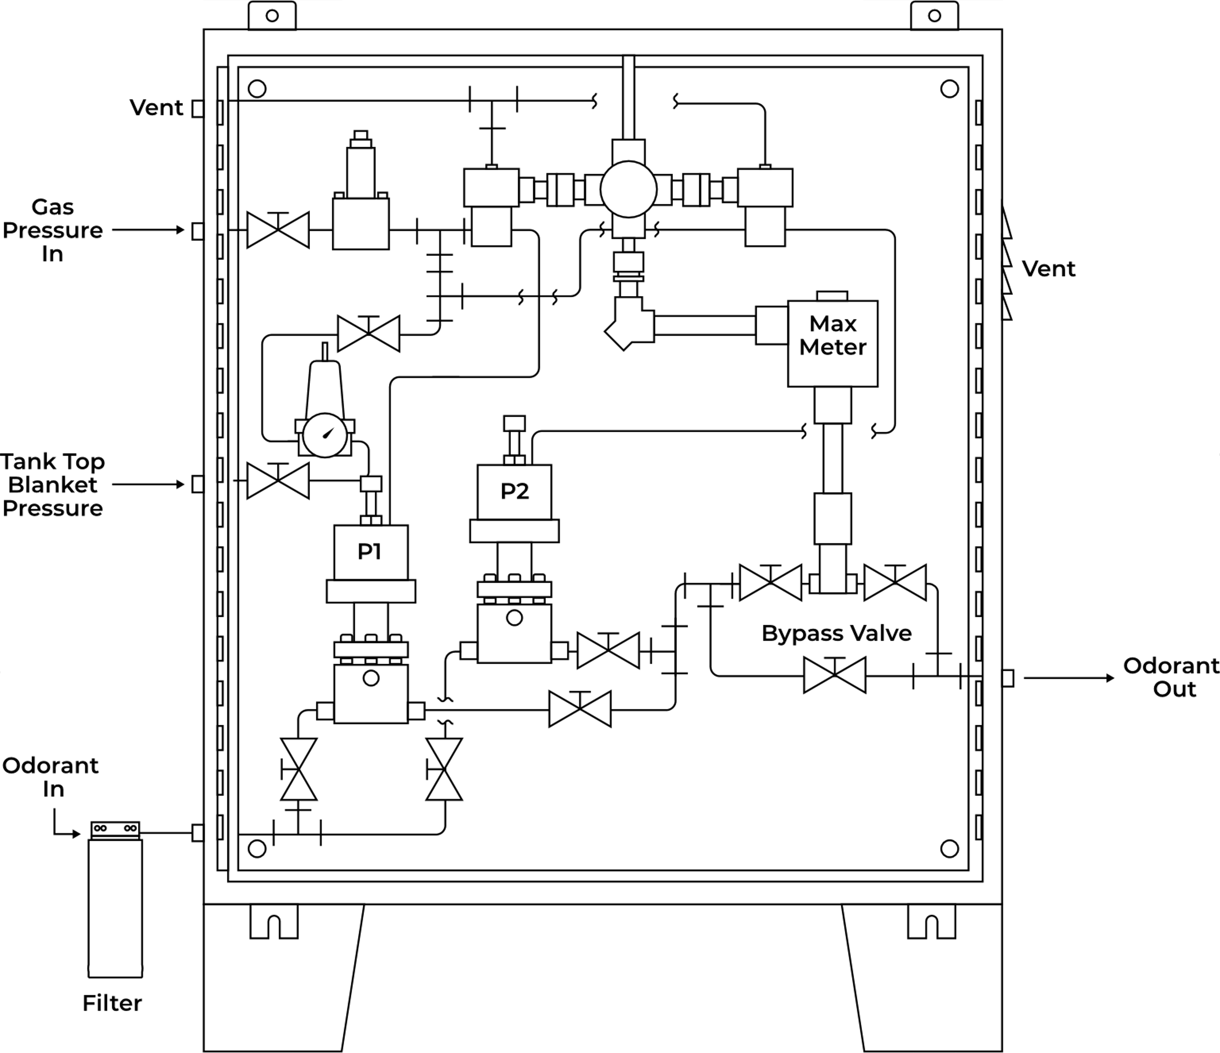
Pump Liquid Injection
How It Works
A positive displacement pump is used to push odorant into the line at a controlled rate
Advantage:
Odorize gas at higher volumes and pressures
Operates in lines with no pressure drop
Some systems allow the use of multiple pumps for extremely high flow rates using one controller
Disadvantage:
Dynamic seals wear
Notes:
Most pump systems are essentially similar to this with their own variations. YZ and Welker

Slide 16
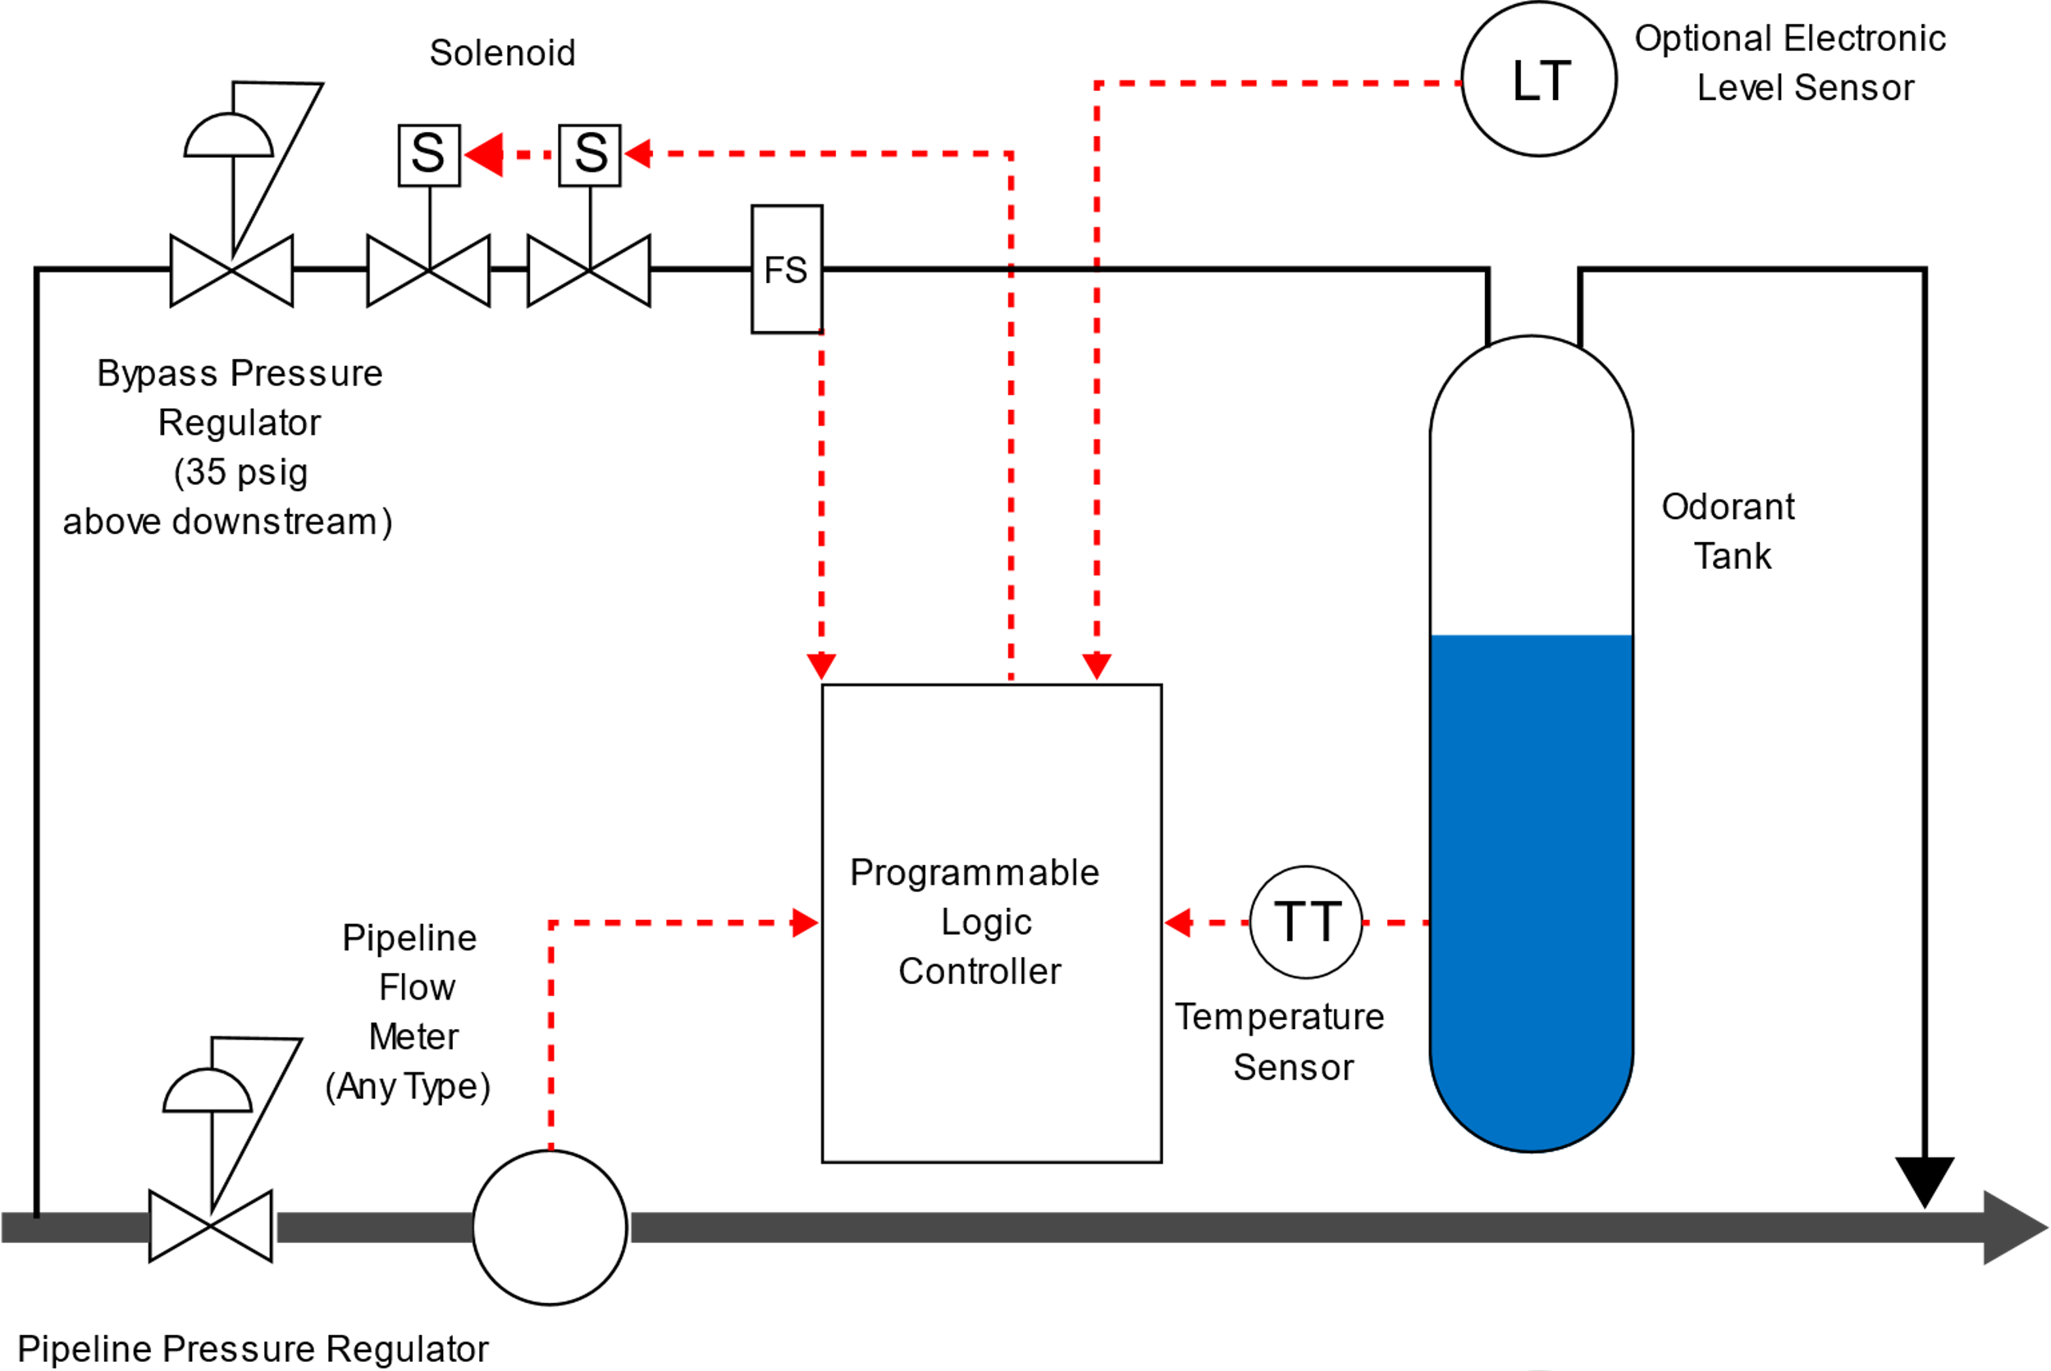
Pumpless Vapor Injection
How It Works
Unit diverts un-odorized gas through odorant tank to mix with odorant vapors, saturated gas is return to the down stream line.
Advantage:
Odorant rate is constantly corrected for pressure, temperature and flow variations
System allows for repairs prior to gas/odorant infusion
No issues with vapor locking pumps
NOTE: Differential pressure in the line is a requirement
Notes:
Welker, Preco

Slide 17
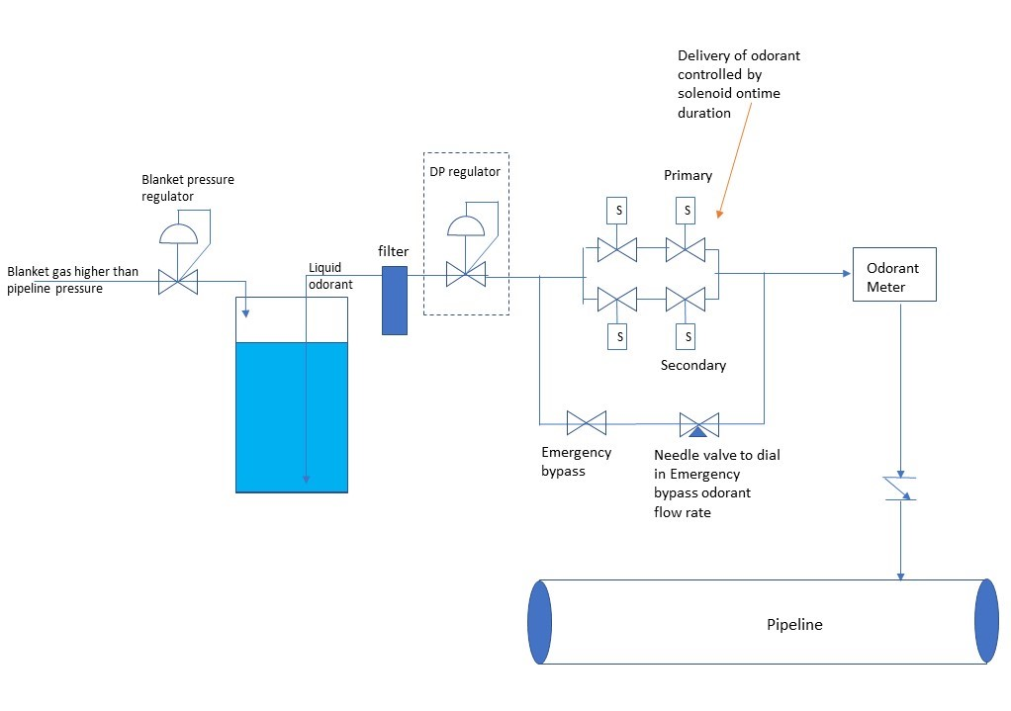
Pumpless Liquid Injection
How It Works
Unit utilizes pressurized gas to generate a blanket pressure on tank higher than pipeline. This pressure is used to inject liquid odorant
Advantage:
Odorant injection at constant rate by varying injection amounts
No gas emissions
No issues with vapor locking pumps
NOTE: Differential pressure in the line is a requirement
Notes:
Welker, GPL

Slide 18
Installation Considerations for Odorization
Secondary containment
Hazards
Equipment protection
Sensitive areas

Slide 19
Secondary Containment
Secondary containment is required to contain any spills that might occur to prevent costly environmental cleanup
Preferred is powder coated or galvanized steel
Concrete can be used, but as it is porous, it will absorb some odorant and continue to smell strongly even after cleanup.

Slide 20
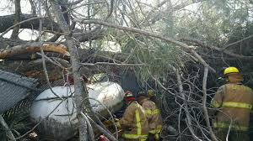
Natural Hazards
The Risk
Odorant is stored under pressure in the tank
Debris from a storm may damage the tubing, allowing the odorant to spill
Even if it is captured with in the secondary containment, the odor will be overwhelming
Respirators will likely need to be worn to clear debris
Meanwhile, the populace for miles around will be disturbed by the smell and making leak calls.

Slide 21
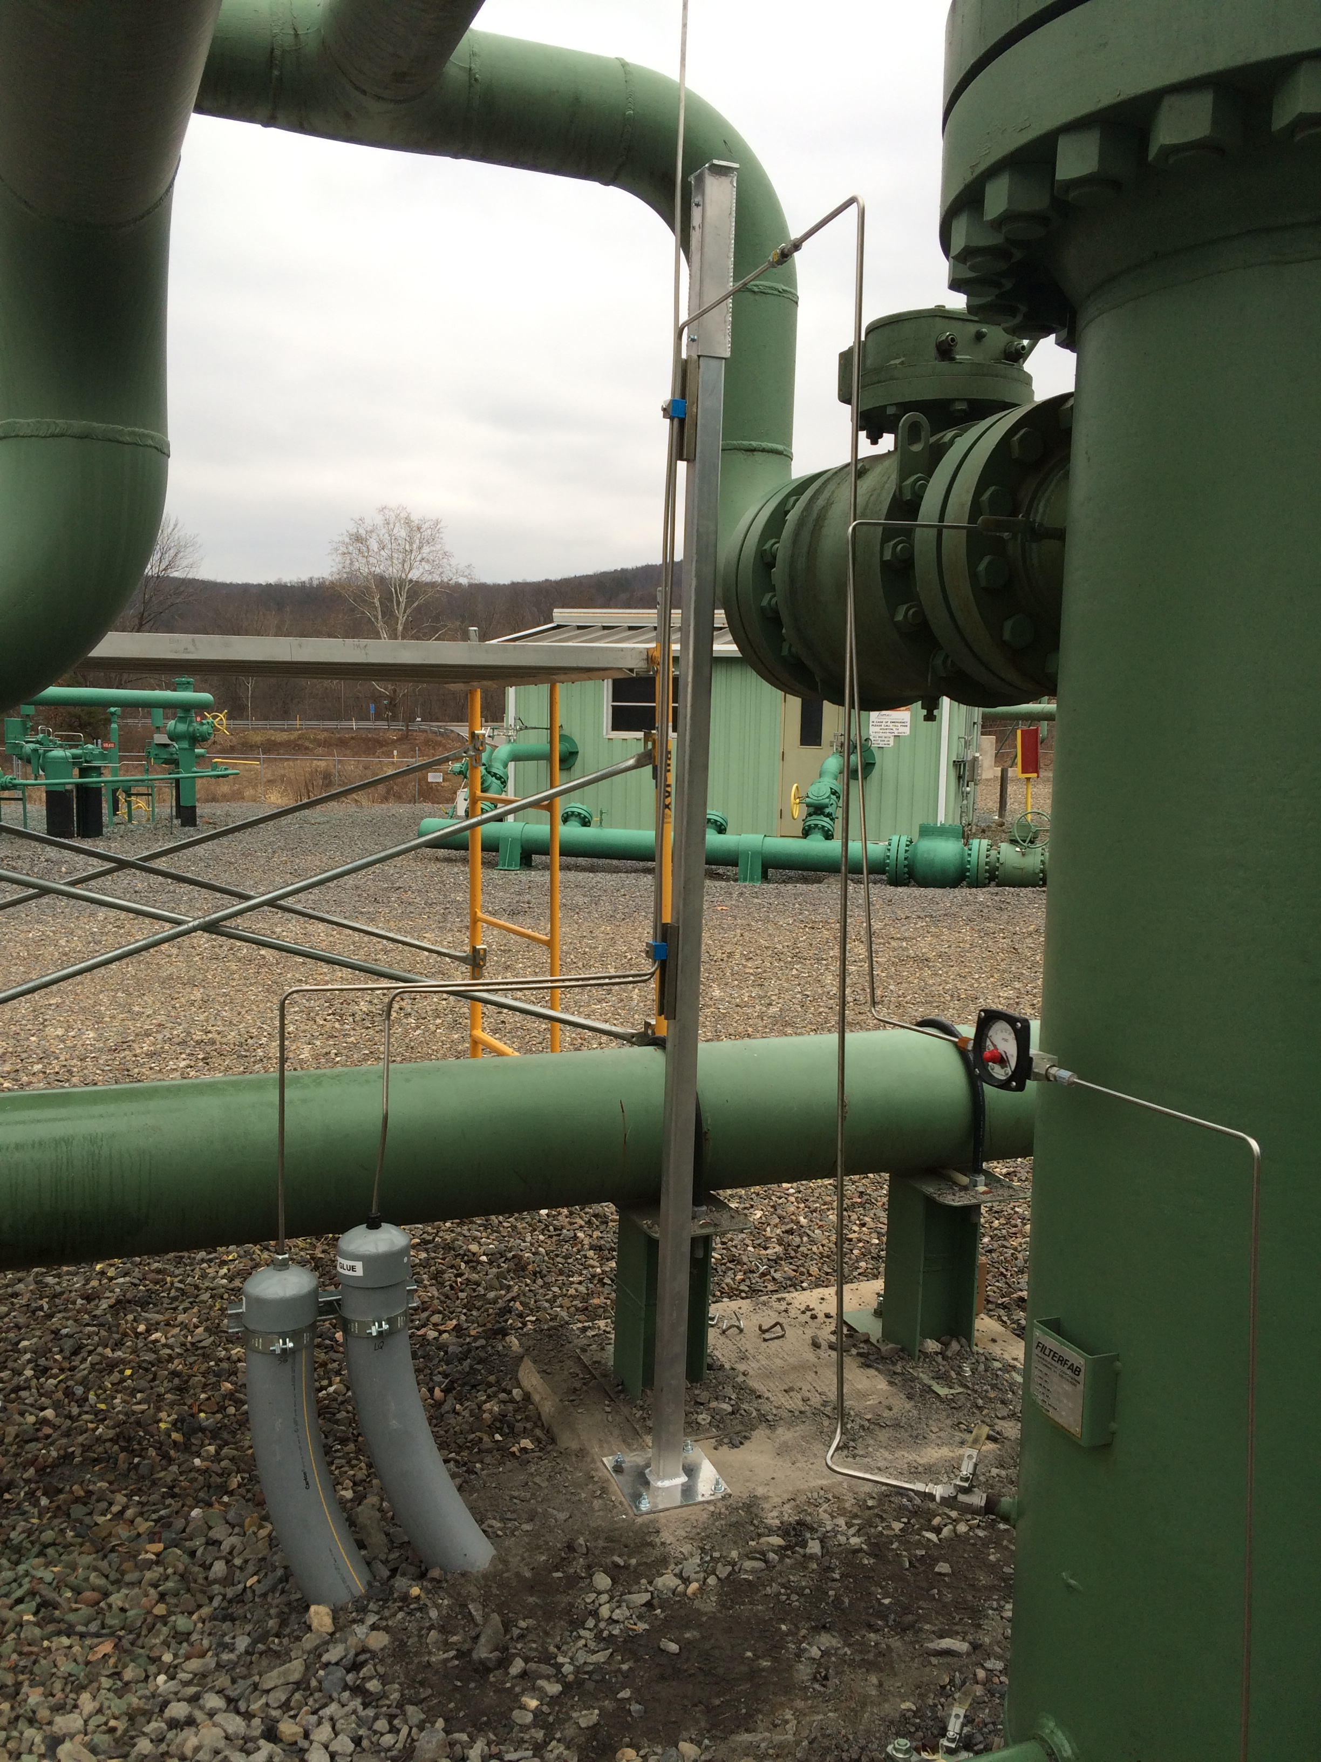
Equipment Protection
Tubing
Odorant is pumped to the pipeline under high pressure
Any leak in the tubing may cause odorant to spray out uncontrollably
Protect the tubing underground with secondary conduit
Protect the tubing above ground by attaching to permanent structures

Slide 22
Equipment Protection
Shelter
A shelter such as this can help protect against falling or windblown debris.
Additionally, it keeps the system away from prying eyes and general mischief.
Even a simple metal shade canopy offers some protection from the elements.

Slide 23
Sensitive Areas
The Risk
The location for an odorizer cannot always be placed in a remote area.
Proximity to hospitals, nursing homes, schools, and churches requires extra consideration.
Even during normal situations such as standard maintenance odor can be released

Slide 24
Supporting Technologies for Odorization
Sniff Test
Filtration
Spill kit
Flare
Neutralizer
Level monitoring

Slide 25
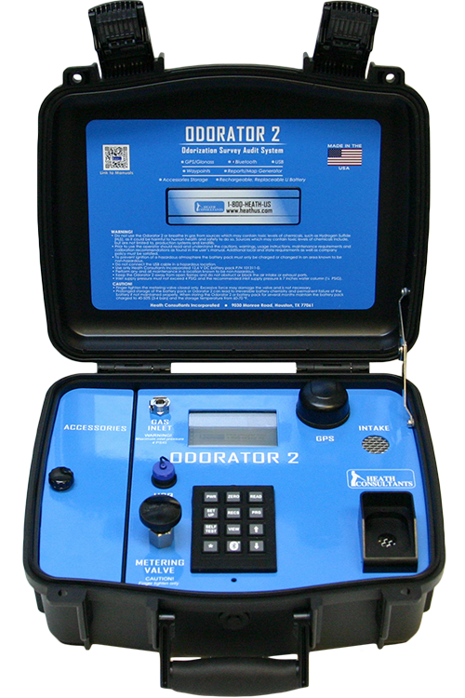
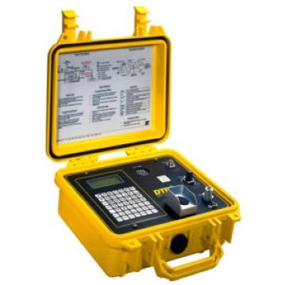
Sniff Test
“readily detectable by a person with a normal sense of smell”

Slide 26
Odorant Measurement
Automatic sampler
Manual sampling

Slide 27
Filtration
Liquid
Gas
Exhaust

Slide 28
Spill Kit
Odorant Spill Kit
PPE
Absorbent
Odorant neutralizer
Cleanup tools
Steel drum / plastic overpack
Welker
MRR
Perc

Slide 29
Odorant Flare
Odorant Flare
Used to flare off blanket gas from odorant tanks or blow down small lines

Slide 30
Odorant Removal
Neutralizers
Chemical
Enzymatic
Notes:
Note the difference between neutralizers and masking agents

Slide 31
Thank you!
281.123.4567
email@welker.com
12345 Address Street City, State 12345

